Slide 1

PROJECT MILESTONE - 2
TEAM : TERMINAL Commandos
TEAM MEMBERS :
GLENN MUGA
JAGRIT GOYAL
RUTIK REKHAWAR
SAI NITHIN REDDY
SRUTHY SREEKUMAR
CHIRAG SINGHAL

Slide 2


TABLE OF CONTENTS
Problem statement
Tools required
Working
Git, GitHub, Maven, Tomcat
Jenkins
Docker
Kubernetes
Working architecture of Project
Conclusion

Slide 3

Problem statement
Create an end-to-end CI/CD pipeline in AWS platform using
Jenkins as the orchestration tool
GitHub as the SCM
Maven as the Build tool
Deploy in a docker instance
Create a Docker image
Store the docker image in ECR
Achieve Kubernetes deployment using the ECR image
Build a sample java web app using maven.

Slide 4


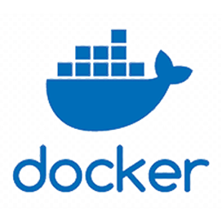
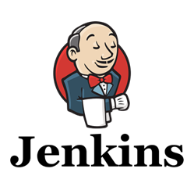
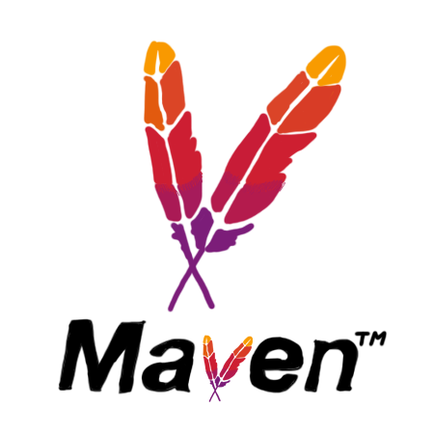
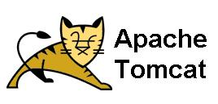
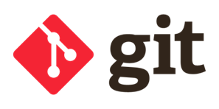
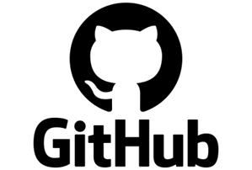

Tools AND Technologies
GitHub :- GitHub is web-based platform that hosts Git repositories, providing developers with tools for version control and collaboration
Jenkins:- Jenkins is an orchestration tool. Using Jenkins we can implement CI/CD.
Maven:- Is a Powerful Build Automation & Project Management Tool used for Java Projects
Docker:- Is a Containerization Platform.
Amazon ECR:- Is a fully managed Docker Container registry service provided by AWS.
Kubernetes:- Is a Powerful Open-Source platform for managing Containerized Application at scale.

Slide 5
Git & GitHub
Git is Version Control system.
GitHub is web-based platform that hosts Git repositories, providing developers with tools for version control and collaboration.
In our project we connected Git to GitHub using SSH.
This ensures Secure Communication Between Local Repository and GitHub.
Pulled Code from my existing repository- this brings the latest changes from GitHub to our Local Machine.

Slide 6
Jenkins
Jenkins has an Extensive Plugin Ecosystem
Jenkins is a Versatile Orchestrator
Working:
Setup Jenkins machine : Install and configure Jenkins
Configured Jenkins : Integrated remote servers for Kubernetes and Docker with Jenkins, ensuring secure SSH connections.
Created Maven Project: Set up a Maven project with the “send build artifacts over SSH” configuration.
Ensured Continuous Deployment: Implemented triggers to automate continuous deployment.

Slide 7
MAVEN & TOMCAT
Maven:- Is a Build Tool
Project Structure:- Compile and package the Application to jar/.War file (java application-.War file)
Maven is a Plugin which we Install in our Jenkin Server.
It simple terms Maven makes your life Easier by Automating.
Jenkins will communicate with Maven whenever new commit is made.
Tomcat :- is an Open-Source Web Server.
Tomcat can be easily Integrated.
Tomcat is Lightweight Application Server and Easy to Configure.
Tomcat is like a middleman that helps your Java Web Application

Slide 8
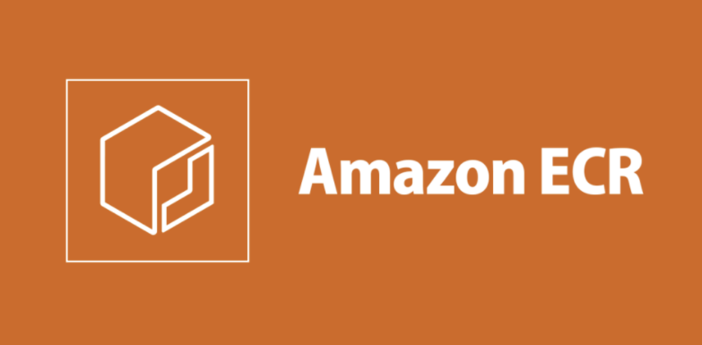
DOCKER
Docker is a platform that enable developers to automates
the deployment of applications using containerization
Created a docker file for java webapp
Dockerized the application by building an image
Pushed docker image to AWS Elastic Container Registry(ECR)
ECR serves as a storage to container images

Slide 9
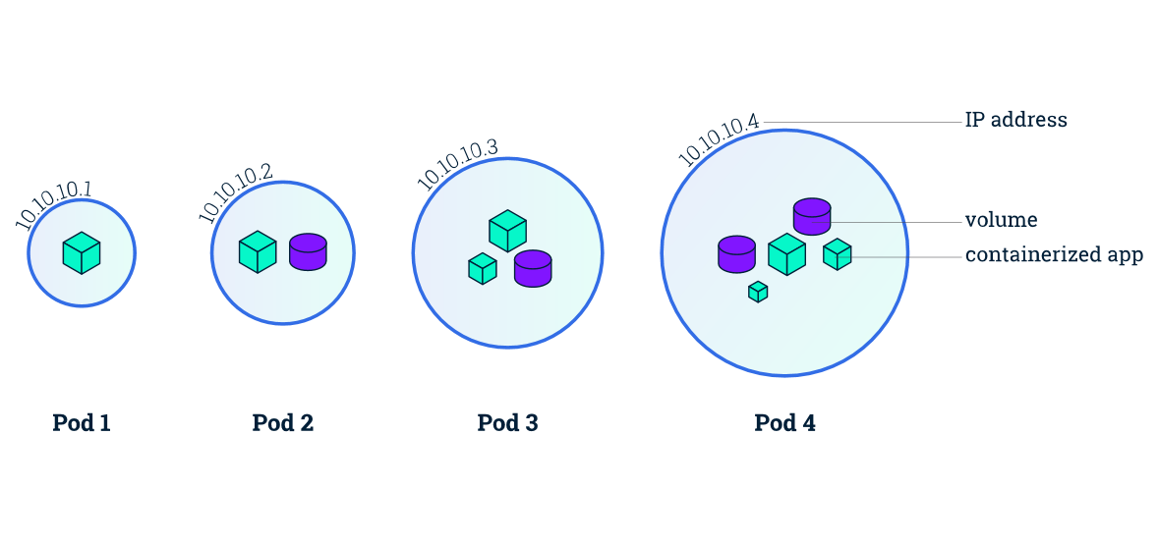
Kubernetes
Container Orchestration – Kubernetes will
ensure the containers run efficiently across a cluster of machines.
Automated Deployment - seamless, continuous delivery of applications by managing container orchestration, scaling, and updates efficiently
Scaling - Kubernetes can automatically scale applications based on demand, ensuring optimal resource utilization.
Self-Healing - can automatically restart failed containers, replace them, and kill containers

Slide 10

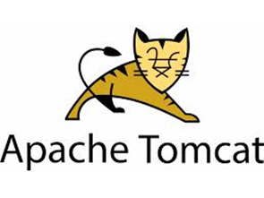
Working architecture
Receive a .war file from maven
Build using maven
It will create and will push the image on ecr
Connect the repo
With Jenkins using
Webhook
Docker will pull the image from Jenkins
Pull the git repo
From the git client
Add ssh-key to connect them
The url of the image will be deployed by kubernetes
Every new build
Will be exposed
On public ip
Deploy the project on the server
Send artifacts of tomcat in a container

Slide 11


CONCLUSION:
We have successfully built the Pipeline , any changes committed on GitHub repo will now be automatically built on Jenkins dashboard and the changes will reflect on the Webpage.

Slide 12
Thank You!
– Terminal Commandos

